Slide 1
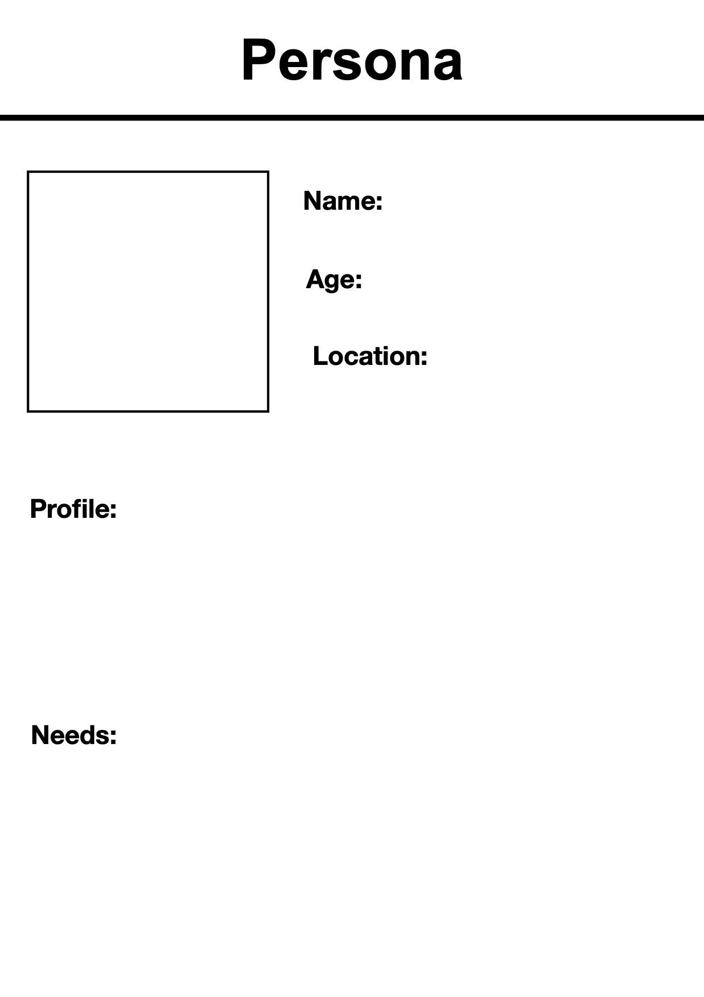
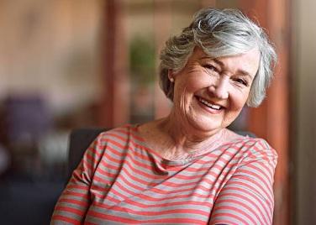
Margaret Sinclair
78
Victoria, BC
(two-bedroom apartment close to Beacon Hill Park)
Retired school teacher who dedicated over 40 years to education
Active member of her local community centre where she participated in weekly book clubs
Values her independence but noticed a decline in her mobility and overall physical capabilities, which is starting to affect her daily routines
She is comfortable using a smartphone to stay connected with friends and family
Her family lives in different parts of Canada, so they cannot be there for her on a day-to-day basis
She is becoming increasingly concerned about her safety when she is home alone
Tools that allow her to monitor her condition in real-time with automatic alerts for people concerned
She wants to stay in her own home for as long as possible and avoid relying on others for daily tasks.
She wants to have easy access to everything at her home

